Slide 1
Bergen Animal Shelter
Dogs, Cats, and Birds

Slide 2
Policies
Adoption
Rescue
Public Health
Wildlife
We are a county-operated shelter providing animal control.

Slide 3
Programs
Education
Adoption
Vaccination
Spay & Neuter
Volunteer

Slide 4
Animals
Dogs
Cats
Birds
Rabbits

Slide 5
Organization
Arianna Benjamin
President
Sarah Chu
Vice President
Ellyn Martinson
Treasurer
Rachel Dumont
Secretary
Notes:
Remember to thank Rita for planning the fundraiser

Slide 6
Funds Raised This Year

Slide 7
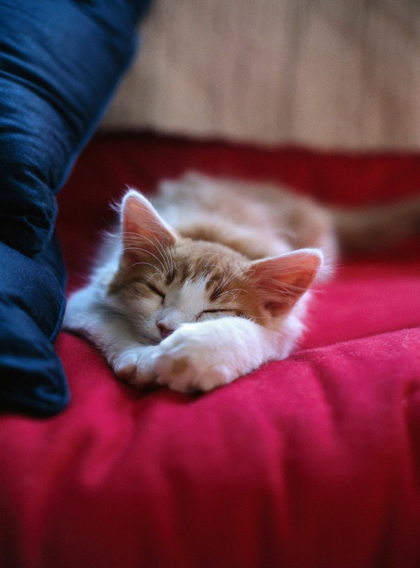
Featured Animals For Adoption
I’m 8 weeks old
I’m a girl kitten
I’m soft and fluffy
I love children
My name is Wilma

Slide 8
Featured Animals For Adoption
5 years old
Orange tabby
Male
Loves kids
All shots

