Slide 1
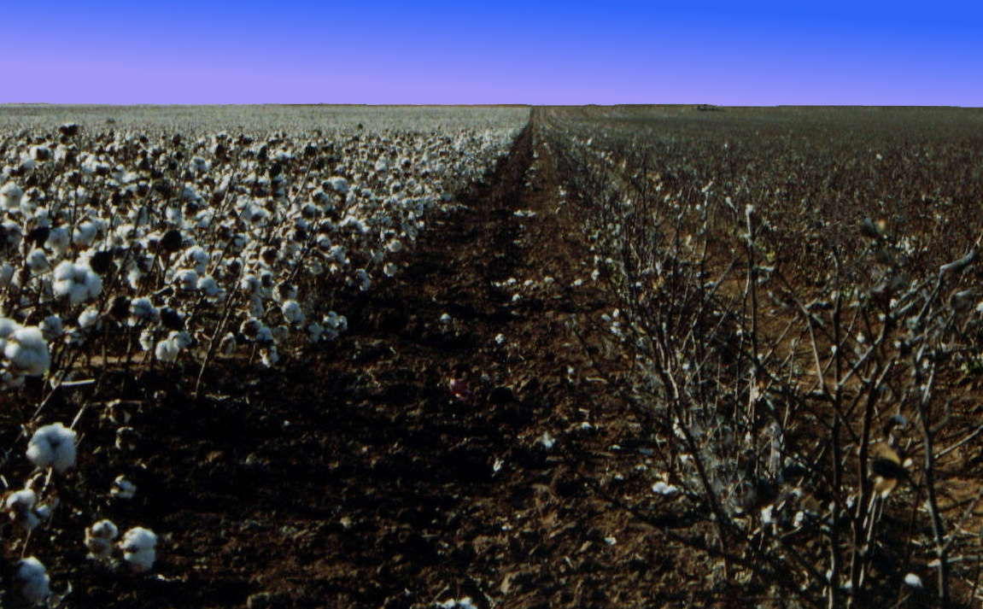
C O T T O N
C O T T O N
C O T T O N
THE STORY OF
C O T T O N
C O T T O N
C O T T O N
C O T T O N

Slide 2
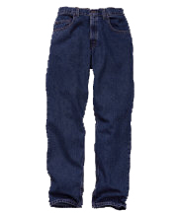
How do they make…?
Jeans
Sheets
Shirts

Slide 3
Basic Facts
Cotton is a plant
It grows wild in many places on the earth
Has been known cultivated and used by people of many lands for centuries
Cotton needs lots of sunshine, water and fertile soil
The boll weevil is the primary insect enemy of cotton

Slide 4
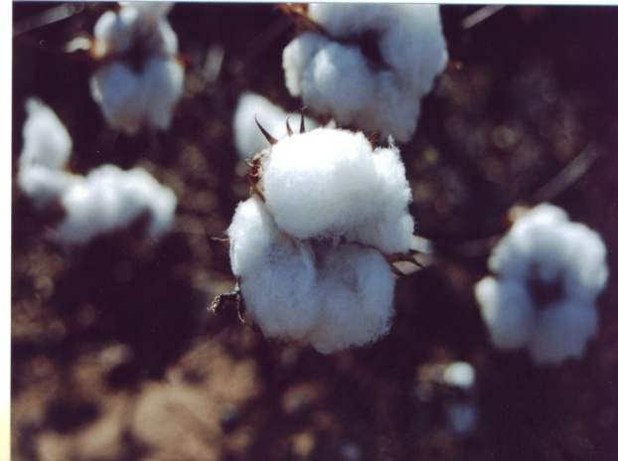
Types of Cotton
Egyptian
Sea Island
American Pima
Asiatic
Upland

Slide 5
People in History
Lewis Paul and John Wyatt
  Roller spinning machine 1738
Samuel Slater
  First US. cotton mill 1790
Eli Whitney
  cotton gin in 1793

Slide 6
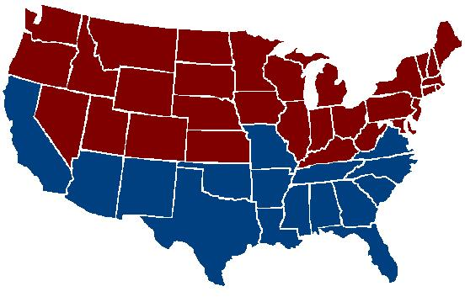
The Cotton Belt
Millions of acres of cotton grow across the Southern United States

Slide 7
Where Does Cotton Grow?

Slide 8
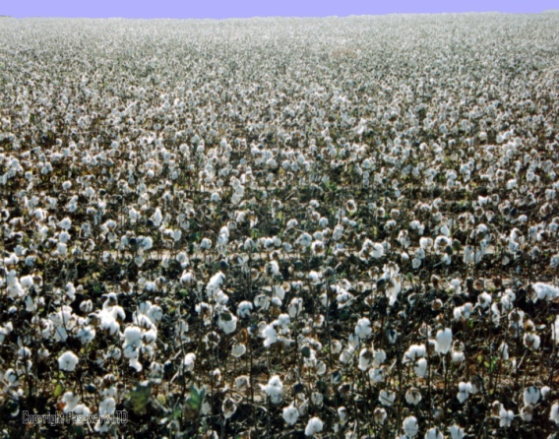
US Cotton States
Upland cotton: Alabama, Arizona, Arkansas, California, Georgia, Louisiana, Mississippi, Missouri, North Carolina, Oklahoma, South Carolina, Tennessee, Texas and Virginia
Pima cotton: Arizona, California, New Mexico and Texas.
Some cotton is also grown in Florida, Kansas and New Mexico.

Slide 9
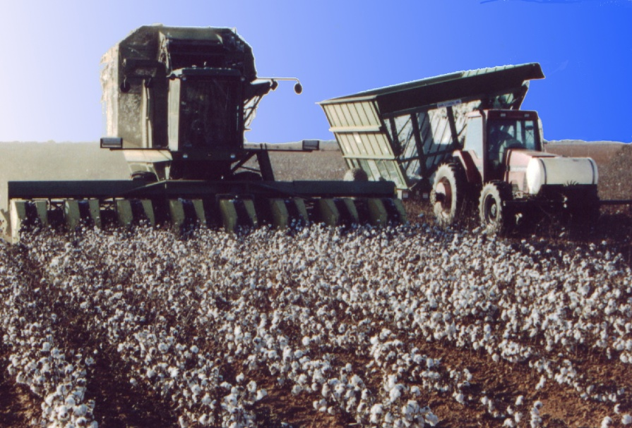
Texas, which annually grows about 4.5 million bales of cotton, is the leading cotton producing state

Slide 10
The Process
Cotton Pickers or Brush Strippers harvest cotton six or eight rows of cotton at a time
Cotton is stored in baskets above the harvester
Cotton is dumped into a cotton trailer when the basket is full
The cotton is transferred from the cotton trailers to a module builder
The module builder compresses the cotton to form a module of cotton

Slide 11
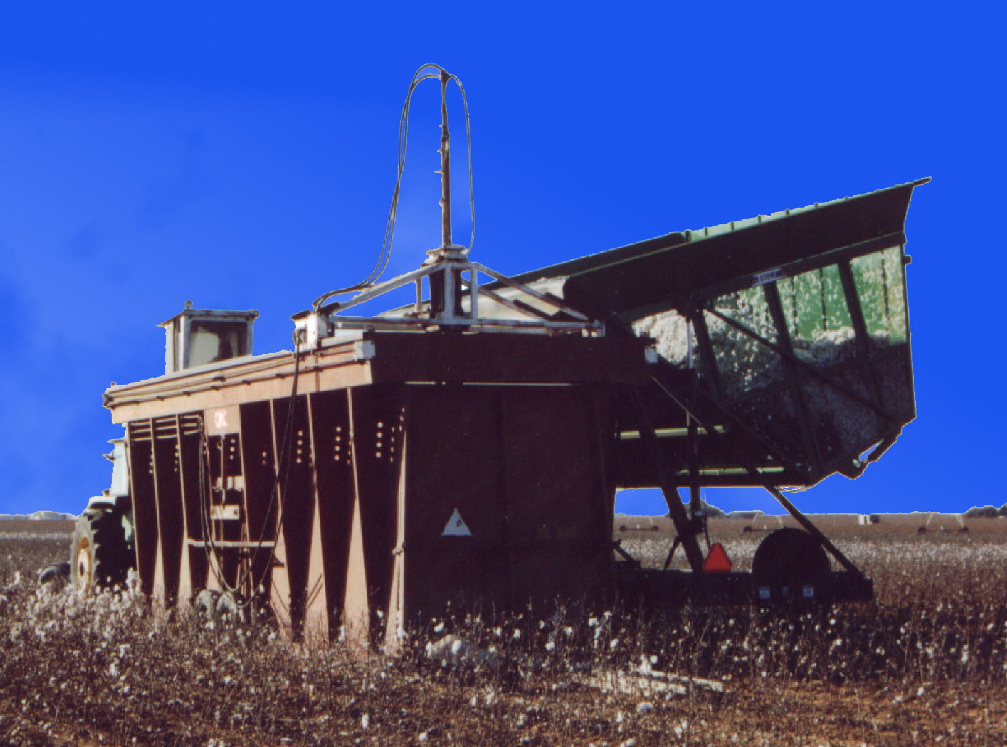

Slide 12
Cotton Processing
Cotton fiber is separated from the cottonseed at the gin
Cotton is vacuumed into tubes that carry it to a dryer to reduce moisture and improve the fiber quality
Cleaning equipment removes leaf trash, sticks and other foreign matter

Slide 13
Bales
The fiber (or lint) is compressed into bales
Banded with eight steel straps
Sampled for classing or grading
Wrapped for protection
Loaded onto trucks for shipment to storage yards, or textile mills

Slide 14
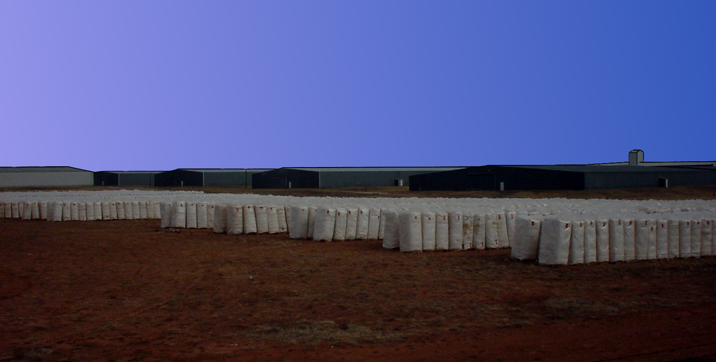

Slide 15
A Bale of Cotton
55 inches tall
28 inches wide
21 inches thick
500 pounds
313,600 $100 bills
215 Jeans
249 Bed Sheets
690 Bath Towels
1,217 Men's T-Shirts
1,256 Pillowcases
1,085 Diapers

Slide 16
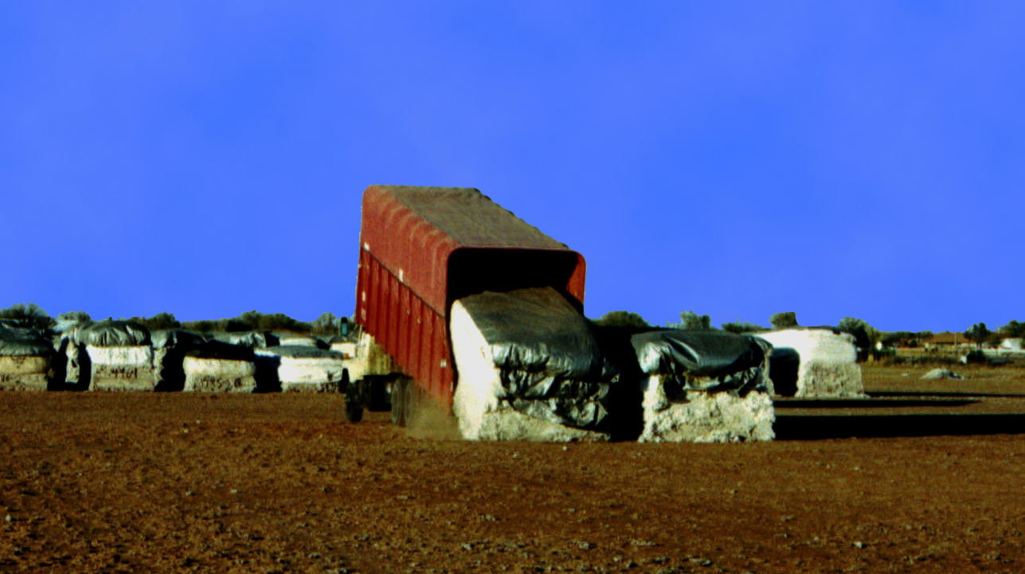

Slide 17
A Cotton Module
Is a compactly pressed block of cotton
Holds 12-14 bales of cotton
Modules are hauled to a cotton gin or to the gin’s storage yard by a module mover

Slide 18
Cotton Production in Millions of Bales

Slide 19
Products and Byproducts of Cotton

Slide 20
Cotton Seed Oil

Slide 21
Textile Mills
Purchase cotton bales from gins or cotton warehouses.
Start with raw cotton and process it in stages
Produce yarn fibers twisted into threads used in weaving of cloth
Cloth is dyed and cleaned, and shipped to clothing producers

Slide 22
The End

