Slide 1
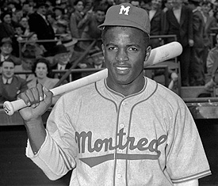
Jackie Robinson
By: Ben Fales

Slide 2
Birth
Jackie Robinson was born on January 31, 1919.
He was born in Cairo, Georgia.

Slide 3
Early Life
Jackie was the youngest of 5 children.
He was raised by a single mother
He attended John Muir High School and after high school he went to Pasadena Junior College.
He played 4 sports
Baseball
Basketball
Football
Track and Field

Slide 4
Early Baseball Career
Jackie Robinson played baseball in college.
Jackie played one year in the Negro Leagues for the Kansas City Monarchs.

Slide 5
Jackie in the Army
Jackie Robinson enlisted in the U.S Army after he was done with college.
He spent 2 years in the Army. He was promoted to 2nd Lieutenant.
Robinson was forced to leave the Army after he refused to stand in a bus because he was black.
Robinson was finally granted an honorable discharge.

Slide 6
Major League Contract
On August 28, 1946 Jackie Robinson signed a contract with the Brooklyn Dodgers.
He played one year for the Dodgers minor league team the Montreal Royals.

Slide 7
Major League Debut
In 1948 Jackie Robinson played in his first full season in the major leagues.
Robinson won the Rookie of the Year award for his accomplishments in 1948.
In his second season in the majors Robinson won the league MVP award.
Jackie Robinson was the first African American to play in the Major leagues.

Slide 8
Hall of Fame
Jackie Robinson was inducted in to the Baseball Hall of Fame in 1962.
He was inducted in his first year of eligibility.

Slide 9
Death
On October 25, 1972 Jackie Robinson died of a heart attack in his home.
He was 53 years old at his death.

Slide 10
Why Jackie Robinson is a Hero
Jackie Robinson is a hero for many reasons.
He was the first African American to play in the Major leagues
He kept quiet even when other people were yelling out threats and racial slurs against him.
He opened the door for other African Americans to play sports.

