Slide 1
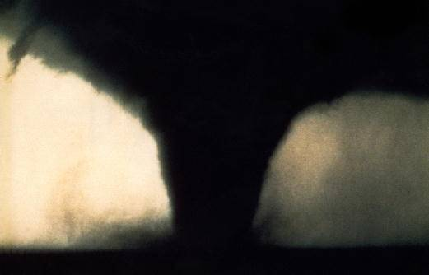
Tornadoes
NSSL/SPC

Slide 2
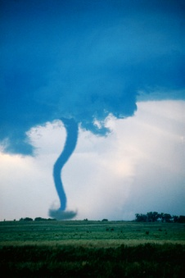
Tornado Facts
A tornado is a rotating column of air attached to a thunderstorm that comes in contact with the ground.
The most violent of all atmospheric events is the tornado.
On average, 800 to 1000 tornadoes occur in the U.S. each year.
Tornadoes occur in every state in the U.S.
Tornado winds can reach 300 mph.

Slide 3
Tornado Facts
Tornadoes can be a mile or more wide.
Tornadoes can travel at speeds from almost stationary to 70mph.
The life of a tornado can exceed one hour.
Tornadoes most likely occur between 3 and 9 pm.
Tornadoes may appear transparent until dust and debris are picked up.
On average, tornadoes kill about 60 people a year.
Notes:
Tornadoes can occur anywhere in the U.S. at any time of the year. In the southern states, peak tornado season is March through May, while peak months in the northern states are during the summer.

Slide 4
Tornado Strength
The strength of a tornado is determined by using the
Fujita - Pearson Tornado Scale
F-0: 40-72 mph
chimney damage, tree branches broken
F-1: 73-112 mph
mobile homes pushed off foundation or overturned
F-2: 113-157 mph
considerable damage, mobile homes demolished, trees uprooted
F-3: 158-205 mph
roofs and walls torn down, trains overturned, cars thrown
F-4: 207-260 mph
well-constructed walls leveled
F-5: 261-318 mph
homes lifted off foundation and carried considerable distances, autos thrown as far as 100 meters

Slide 5
States Where Most Tornadoes Occur
Texas
Oklahoma*
Kansas
Florida
Nebraska
Iowa
Missouri
Illinois
Louisiana
Colorado
*Oklahoma City has been hit by more tornadoes than any other city since 1890

Slide 6
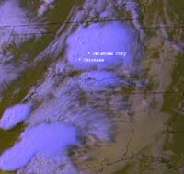
Satellite Image
On May 4, 1999 — Oklahoma experienced about 40 violent tornadoes.
Tornadoes struck heavily populated areas.
Was the sixth deadliest tornado outbreak in Oklahoma history.
This image was captured by NOAA's GOES-8 (Geostationary Operational Environmental Satellite)

Slide 7
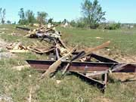
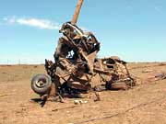
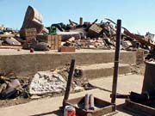
Photos of Oklahoma
May 3, 1999 tornado outbreak
Photos by Curtis Carey, NOAA's National Weather Service public affairs.

Slide 8
Since 1950:
Tornadoes have caused over $30 billion in damage in the United States.
Tornadoes have injured over 75,000 people in the United States.
Tornadoes have killed over 4,500 people in the United States.

Slide 9
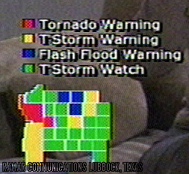
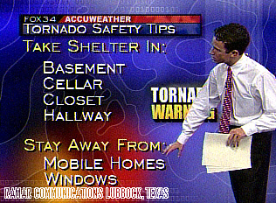
Tornado Forecasting
Meteorologist can predict severe storms and issue warnings that appear on your television or computer screens

Slide 10
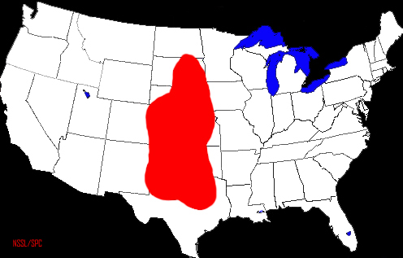
Tornado Alley
The red area represents the region that has the highest occurrence of tornadoes.
This region is known as “Tornado Alley.”

Slide 11
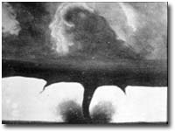
Tornado Photography
This is the oldest known photo of a tornado. It was taken on August 28, 1884 near Howard, South Dakota. The name of the photographer is not known.

Slide 12
Web Resources
http://www.nssl.noaa.gov/edu/safety/tornadoguide.html
http://www.noaa.gov/tornadoes.html
http://www.fema.gov/kids/tornado.htm

